Slide 1
Heat Illness Presentation
Prepared By: Junior Jean
Text provided by: John J. Doherty, MS, PT, ATC, ITAT

Slide 2
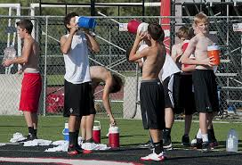
Dehydration
Nearly ¾ of student athletes currently start practice already dehydrated

Slide 3
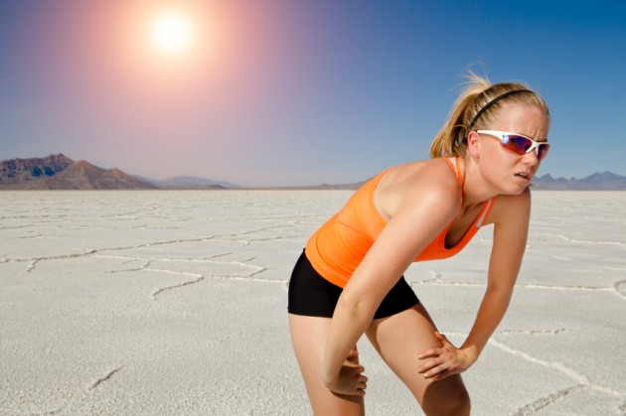
Athletic Performance
An athlete who is dehydrated by as little as 1-2% of his or her body weight can expect to experience a decrease in performance of 10-15%

Slide 4
Prevention
Dehydration can be prevented by monitoring body weight (i.e. Weighing in and out of every practice, urine color, etc.)
For every pound lost during practice or game, the athlete should consume 16-20 oz. of fluid prior to the next practice or within six hours of practice ending if there is not another practice that day.

Slide 5
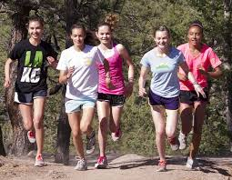
Heat Adaptation
Heat acclimatization takes up to10-14 days and athletes would be better off working on that during the summer than waiting for the first day of fall practice.
For safety reasons, however, the IHSAA also mandates a period of heat acclimatization during the first two weeks of fall football practice. See Rule 54-4

Slide 6
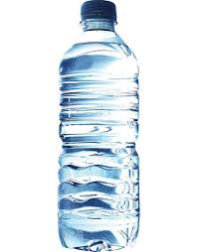
Beverage choices
The beverage of choice is COLD WATER!
Any activities longer than 45 minutes, a sports drink may be advised.
During practice, the typical water break should occur every 15-20 minutes but more frequently if dictated by the weather.
Coaches should NEVER restrict fluid intake during practice.
NO ENERGY DRINKS, CAFFEINATED BEVERAGES!

Slide 7
Symptoms
Athletes should know the warning and signs and symptoms of heat illness to recognize in themselves and teammates.
If they experience these signs and symptoms or recognize them in others, they should alert their athletic trainer and/or coach.

Slide 8
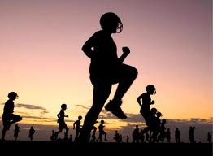
Schedule Change
To reduce the likelihood of heat illness, a coach or administrator may alter the time and nature of practice.
Athletes should be prepared for such schedule changes.

Slide 9
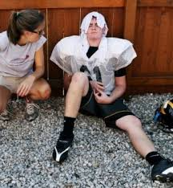
Read and React
Exertional heat stroke causes more sports-related deaths than any other illness or condition but it is the most preventable and the most treatable if treatment is initiated in a timely manner.

Slide 10
Indiana High School Athletic Association
For more information contact:
Robert E. Faulkens
Assistant Commissioner
Indiana High School Athletic Association
9150 N. Meridian St., P.O. Box 40650
Indianapolis, IN 46240-0650
317-846-6601
FAX 317-575-4244
www.ihsaa.org
www.ihsaa.net

